Slide 1






Name of Project - E-Waste Image Dataset:
Classification & Detection
Submitted By – Ripendra Kumar Yadav
TIT college , RGPV , Bhopal M.P
Edunet Foundation
Shell Skill4Future (AICTC)
Submission Date
July 2025

Slide 2

Learning Objectives
The aim of this project is to leverage image classification techniques using machine learning and deep learning to detect and categorize different types of e-waste. This supports the initiative toward smarter and more sustainable waste management practices.
Key Objectives
GOAL
Develop an image classification model for e-waste categories
Automate the detection and sorting process of electronic waste
Utilize deep learning techniques (e.g., CNNs) for accurate visual recognition
Promote responsible e-waste handling and environmental sustainability
Create a reusable dataset pipeline for further research or deployment
Source :
www.freepik.com/

Slide 3

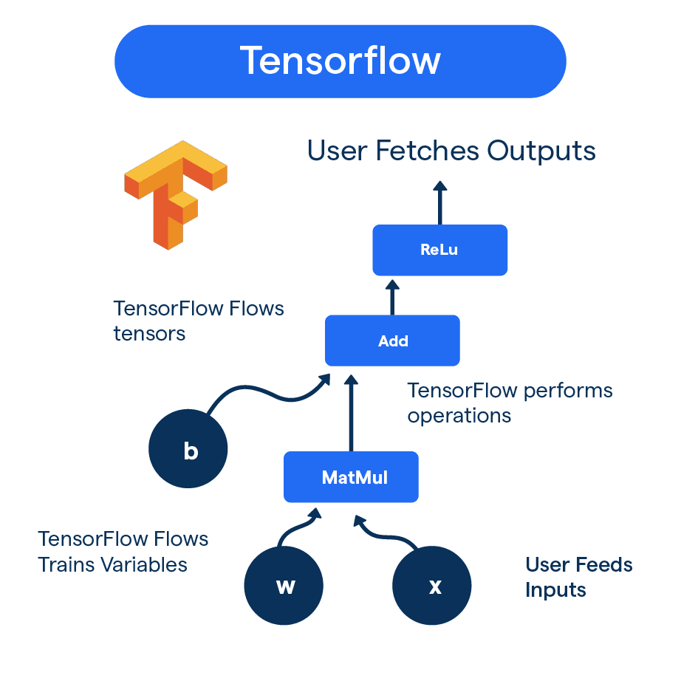
Tools and Technology Used
The following tools and technologies were used throughout the development and deployment of the E-Waste Image Classification project :
🔧 Programming Language & Environment
Python 3.x
Jupyter Notebook
🧠 Libraries and Frameworks
TensorFlow
Keras
Pillow(PIL)
🤖 Model and Technique
EfficientNetV2B0 (Transfer Learning)
Data Augmentation (Random Flip, Rotation, Zoom)
Gradio (for deployment interface)
🖼️ Dataset
E-Waste Image Dataset from Kaggle
(URL: https://www.kaggle.com/datasets/akshat103/e-waste-image-dataset)

Slide 4
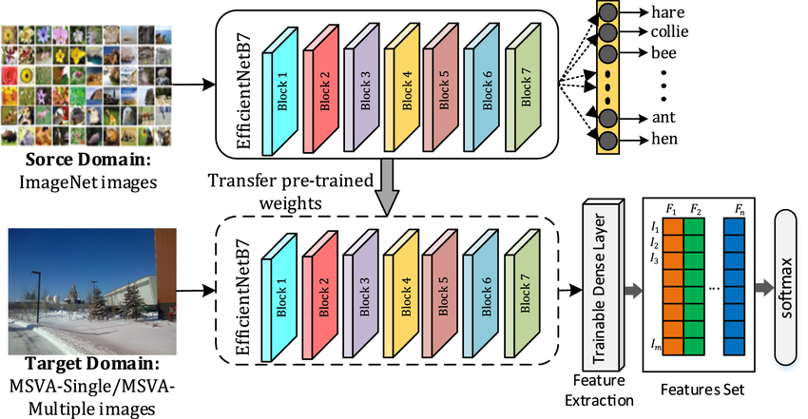
Methodology
The methodology involves building an image classification model for e-waste using transfer learning with EfficientNetV2B0. The project follows a structured pipeline from data preparation to model deployment.
⚙️ Step-by-Step Process:
1. Dataset Collection
E-Waste Image Dataset (10 classes) from Kaggle
Structured into train, validation, and test folder
2. Data Preprocessing
Image resizing (128×128), normalization
Data augmentation: RandomFlip, Rotation, Zoom
3. Model Building
Used EfficientNetV2B0 as the base model (pre-trained on ImageNet)
Added custom classification head (GlobalAvgPool, Dropout, Dense)
4. Training and Fine-Tuning
Frozen first 100 layers of the base model
Trained remaining layers + custom head
Used Adam optimizer, SparseCategoricalCrossentropy, EarlyStopping
5. Evaluation
Measured accuracy, loss, confusion matrix, and classification report
Achieved ~90% accuracy on the test dataset

Slide 5
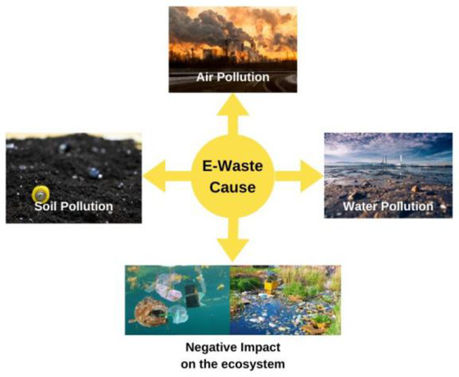
Problem Statement:
🌍 E-waste is the fastest-growing waste stream worldwide. Improper disposal causes toxic pollution, health hazards, and loss of valuable resources
🚫 Traditional waste management methods are no longer effective for handling its scale and complexity.
⚠️ What’s the Problem?
❌ Manual sorting is slow, costly, and error-prone
🧪 Contains hazardous materials harmful to people and nature
📉 Inefficient recycling leads to environmental damage
⚙️ Need for automation in e-waste identification and sorting
📈 Rapid growth of e-waste outpaces current handling methods
🔍 Difficulty in distinguishing between similar-looking waste items

Slide 6
Solution:
🧠 Our solution uses AI-powered image classification to automate the detection and categorization of e-waste items.
💡 How Our Project Solves the Problem:
🤖 Uses EfficientNetV2B0 (transfer learning) to classify e-waste images
⚙️ Automates sorting, reducing manual effort and human error
⏱️ Increases speed and accuracy of e-waste identification
🌿 Supports eco-friendly waste management and recycling
🧪 Handles visual similarity between different e-waste items effectively
🖥️ Provides a Gradio-based web app for real-time predictions
🔁 The system bridges the gap between growing e-waste and smart recycling using AI

Slide 7
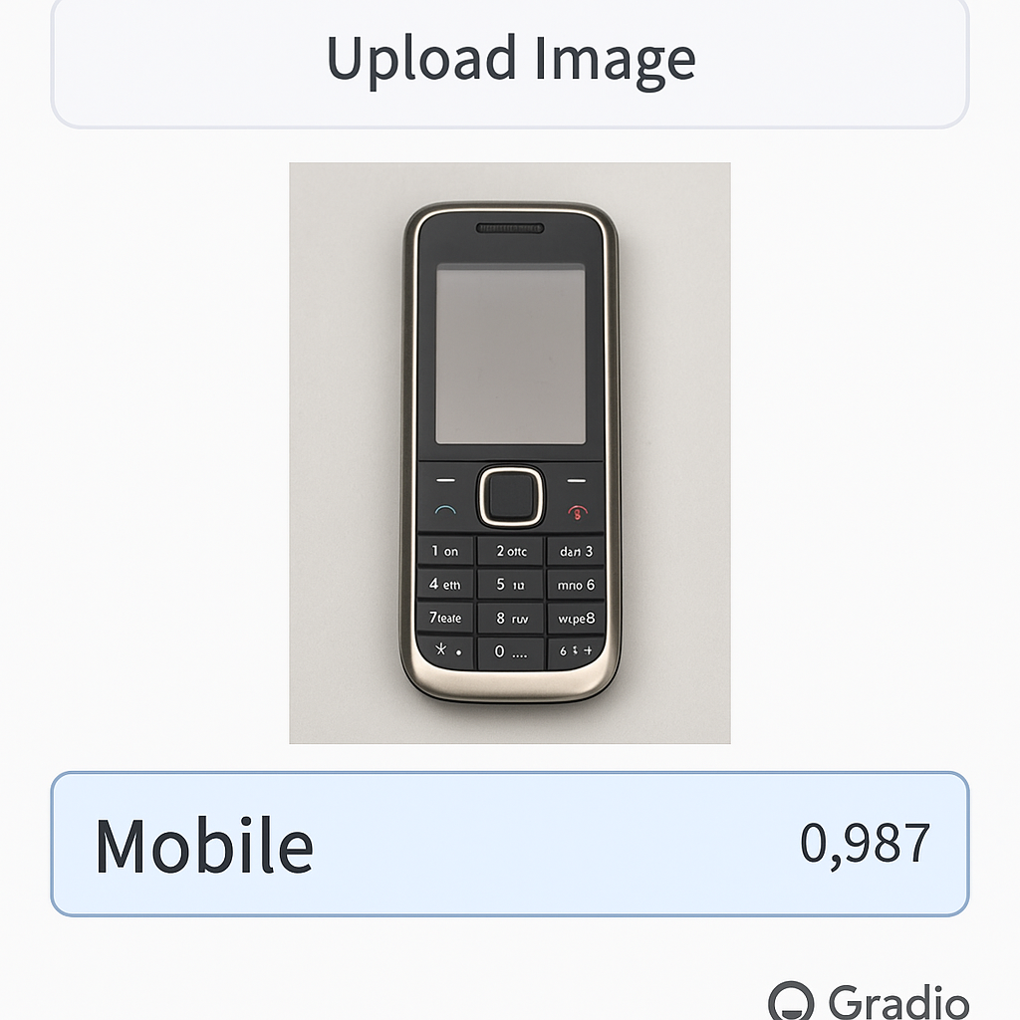
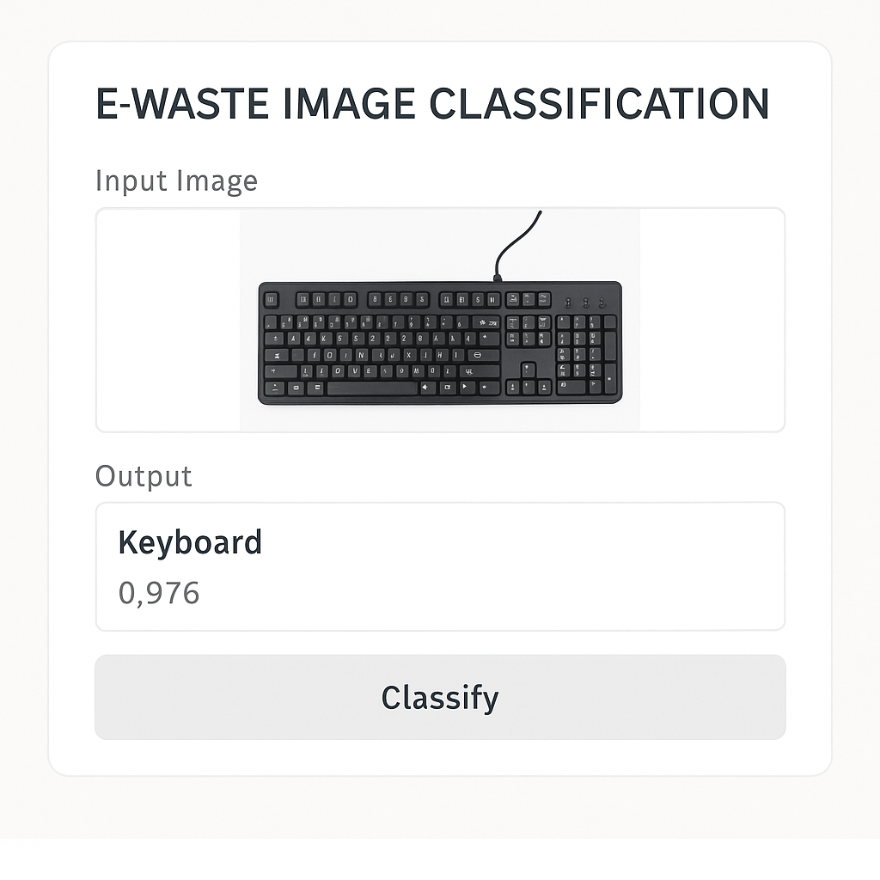
Screenshot of Output:

Slide 8


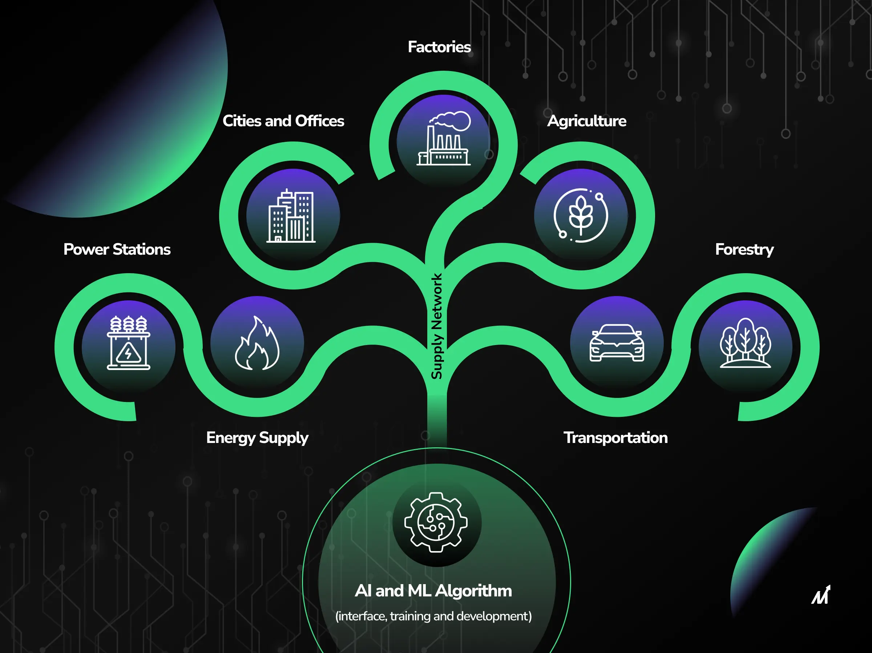
Conclusion:
🧠 Summary of Achievements
This project successfully implemented a deep learning model using EfficientNetV2B0 to automate the classification of e-waste images with high accuracy and efficiency
📌 Impact Highlights
✅ 96% Accuracy achieved on test data
🤖 Reduced manual sorting effort and human error
🌱 Promotes sustainable and smart e-waste management
🚀 Successfully deployed a real-time prediction system using Gradio
🔄 Model generalizes well across 10 diverse e-waste classes
🔭 Future Scope
📈 Improve robustness with larger datasets
📦 Integrate into real-time CCTV or waste bin systems
🧩 Add more e-waste classes and multi-object detection
♻️ This AI solution contributes toward a cleaner, smarter, and greener future
View full code on GitHub:
https://github.com/Ripendra6218/week-1/blob/main/Week2/E_Waste_Generation_Classification.ipynb

